Slide 1
Boston Housing Analysis
By: Rutul Tijoriwala

Slide 2
Abstract
Boston is one of the most densely packed cities in America, with a population of nearly 700,000 people within just 90 square miles
The median per capita income is $45,273, compared to just $33,706 nationwide
I wanted to create data sets that look at median house values, crime, and other variables in order to better understand the city of Boston better
Specifically, see which demographics are hit the hardest by crime

Slide 3
Introduction
Boston’s per capita income has been steadily growing, and its crime is slowly decreasing, relative to other major cities in the United States
However, there are still hotspots in certain neighborhoods where crime is specifically high
I would like to look at these stats, and then potentially create a solution as to how to lower these disproportionate crime rates

Slide 4
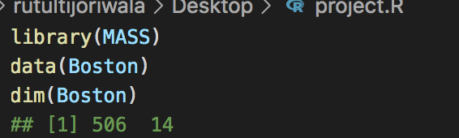
Materials and Methods
I used data from the package MASS – provided me Boston housing data
Used the dim function to confirm that there were 506 entries, with 14 descriptors/variables

Slide 5
Materials and Methods
There descriptors are as follows:
crim – per capita crime rate by town
zn – proportion of land zoned for lots over 25k square feet
indus – porportion of non-retail business acres per town
chas – Charles river variable (1 for bounding river, 0 for not)
nox – nitrogen oxides concentration
rm – average number of rooms per household
age – proportion of units built prior to 1940
dis – weighted mean of distances to 5 Boston employment centers

Slide 6
Materials and Methods
Continued list of descriptors:
rad – index of accessibility to highways
tax – property tax rate per $10,000
ptratio – pupil/teacher ratio
black – 1000(Bk - .63)^2 where Bk is the proportion of blacks by town
lstat – lower status of population
medv – median value of owner– occupied homes by $1000

Slide 7
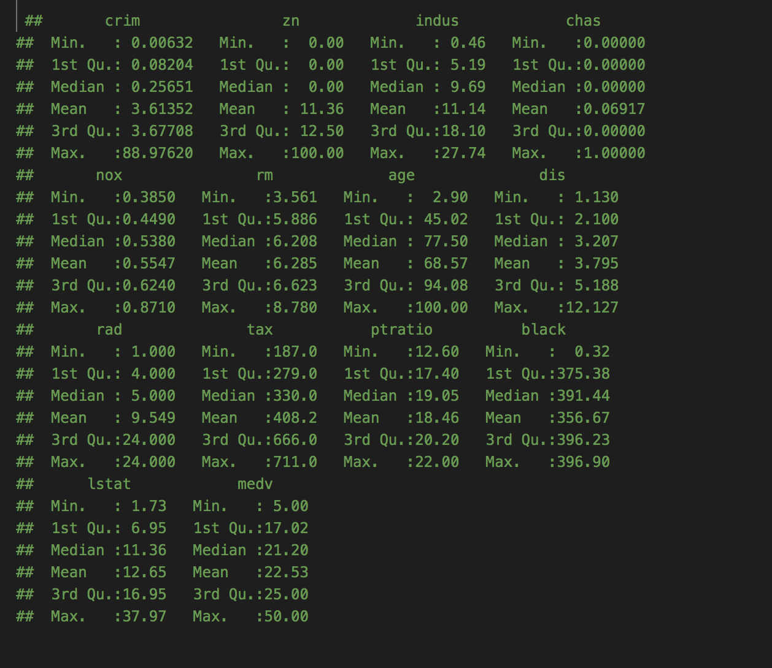
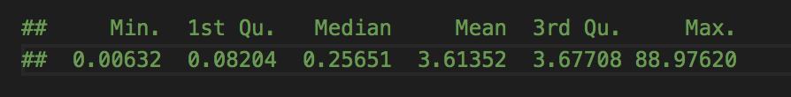
Materials and Methods
First I used summary(Boston) to give me an overall summary of all the descriptors (shown right)
Then I did a summary of the crime rate using the same function (shown bottom)

Slide 8
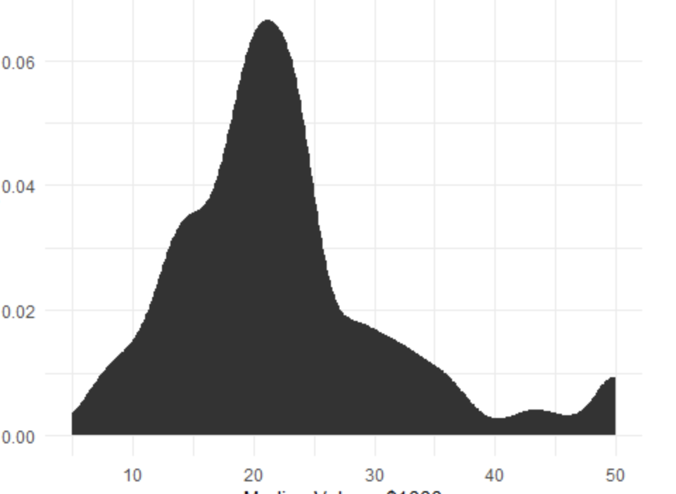
Materials and Methods
I wanted to first see the median household value
This could be done easily using other functions, but it is much easier to understand if shown in a graph
As you can see, most of the houses are around $20,000 in value

Slide 9
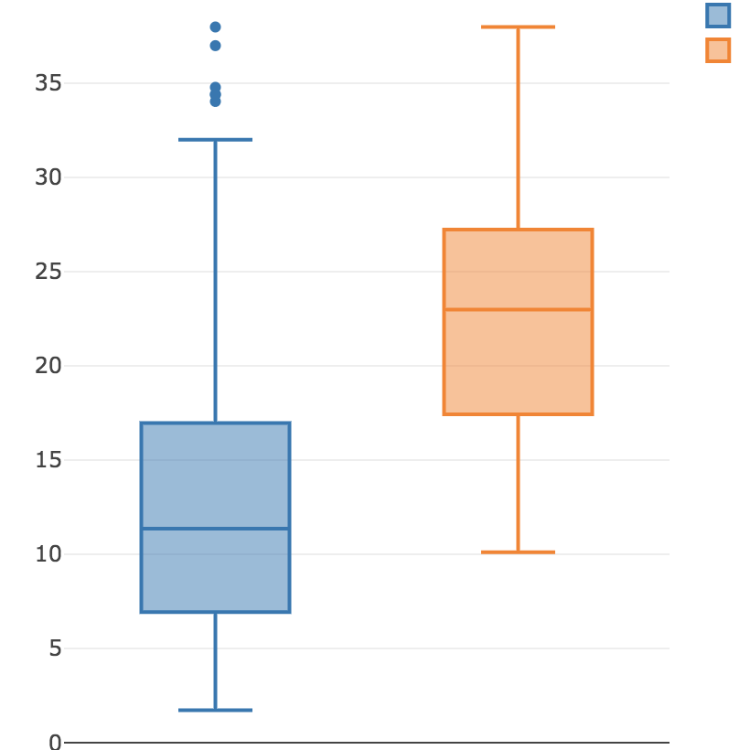
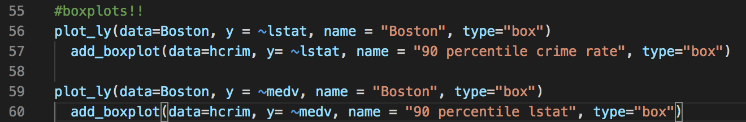
Materials and Methods
To then look at Boston in general, vs areas with neighborhood crime rates in the 90th percentile, I created box plots using plotly
Boston is in blue, neighborhoods with high crime rates are in orange
These two entries are plotted against the variable lstat (lower status)

Slide 10
Materials and Methods
As you can tell from the previous slide, areas with higher levels of lstat (lower income), also have higher crime rates
I then created another set of boxplots that compares medv to crime rates (lines 59 and 60) and it was very interesting
The areas with the most crime also seem to have the lowest median house values

Slide 11
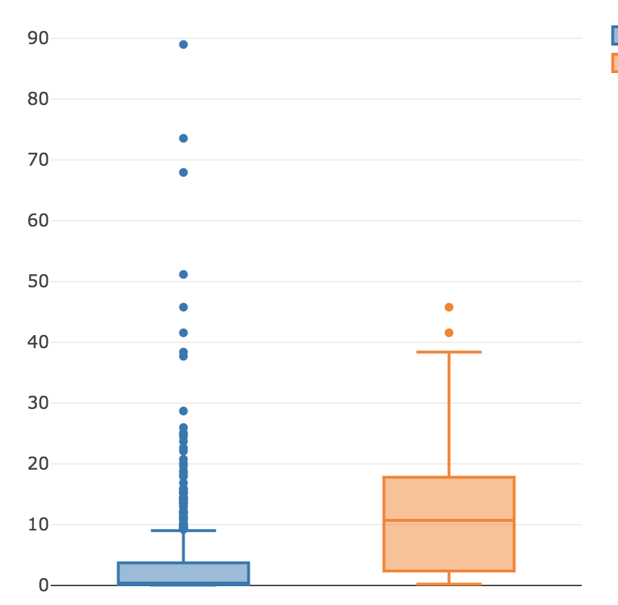
Materials and Methods
Furthermore, I created another boxplot that compares the crime rate to Boston vs. higher levels of lstat (lower income)
Essentially comparing crime rates to Boston overall vs areas with high levels of low income residents
The boxplot is shown on the right, the command is the same as the ones in the previous slides, except you substitute crim into the y variable

Slide 12
Materials and Methods
The boxplot in the previous slide (general Boston area in blue, lower status neighborhoods in orange) show us that neighborhoods with the most amount of lower status individuals deal with crime the most
While there are several high outliers for the general Boston area, these can be ignored due to the high level of entries we have (500+)

Slide 13
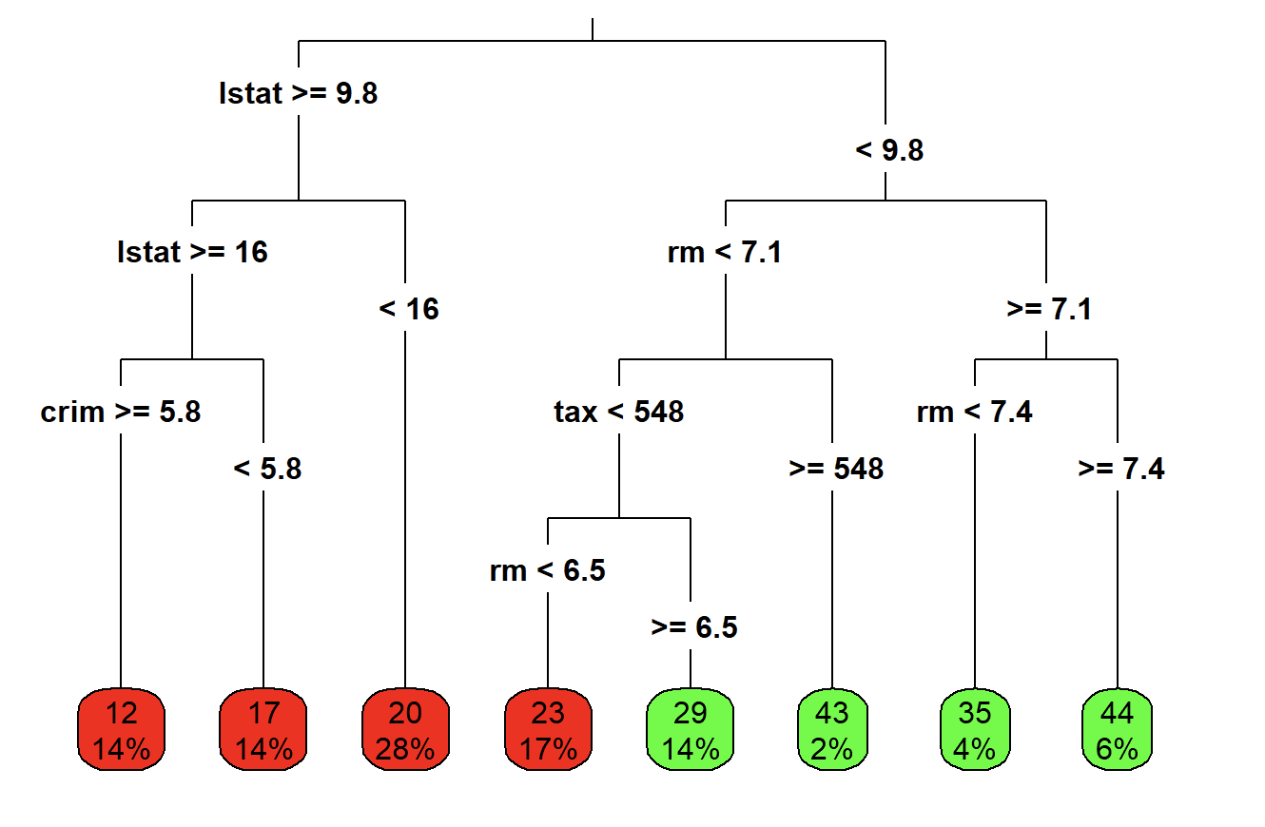
Materials and Methods
Lastly, to compare several other variables, I have created a tree plot that accurately depicts exactly where the highest crime rates occur
The results are staggering
The red leaves are the highest crime rates while the green ones are the lowest

Slide 14
Results
From the boxplots we can see that the most crime-ridden areas in Boston are the ones that have the highest number of lower status individuals
Furthermore, the places with the highest amount of lstat are the most crime ridden
Both boxplots were done in order to show the reader the correlation between lstat and crim

Slide 15
Results
The most descriptive model created, though, was the tree plot (attached again for reference)
The tree plot shows a number of variables as they pertain to crime, and exactly which demographics are suffering the most
As you can see, crime is higher in areas with less rooms per house (smaller homes), lower taxes (lower income), and of course, higher lstat values
Overall, individuals living in lower income areas are more susceptible to suffering from crime

Slide 16
Discussion
From this project I learned that several factors go into crime rates in an area, rather than just income
Though Boston’s crime rate has recently been on a downward trajectory, much more needs to be done to stem the spread of crime
I believe more money needs to be put into education and other infrastructure in order to pull the disenfranchised out of poverty and crime

Slide 17
Discussion
It would be easy to compare ptratio to crim and lstat as well, but all that does is tell you how many teachers there are compared to students
Areas with lower income and thus lower taxes, have less to fund schools, so naturally ptratio will be higher when it comes to areas with high lstat
A simple regression test will confirm this
I would have appreciated if there was another descriptor that gave us information on either completed education or standardized tests to analyze as well, to see how much education suffers in low income/high crime rate areas
Due to time constraints, and other circumstances dealing with COVID-19, I was not able to run more tests and all 14 descriptors, including ones that would take out outliers and create more normal data sets. I would be interested to explore this after this project is completed.

Slide 18
References
General information about Boston - https://www.deptofnumbers.com/income/massachusetts/boston/
General information about Boston - https://datausa.io/profile/geo/boston-ma/
Dataset reference - https://www.cs.toronto.edu/~delve/data/boston/bostonDetail.html
Dataset reference – Mass library in R, using Boston entries

Slide 19
Questions/Comments?
Thank you for your time, please feel free to reach out with any questions/comments/concerns.

